Slide 2
Lost in Translation? What is U=U in the Adolescent Context Globally?
Dr Lee Fairlie
22 July 2019
Share your thoughts on this presentation with #IAS2019

Slide 3
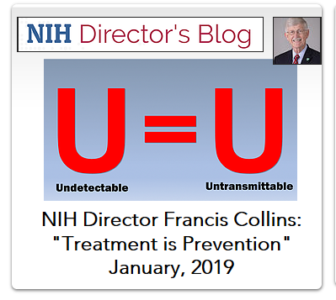

Slide 4
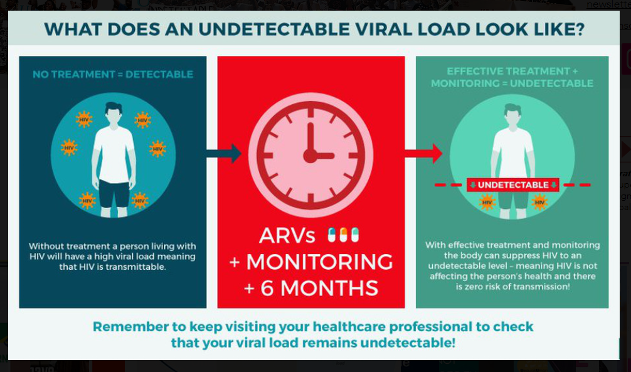
U=U:
Motivation to test, link to HIV care, initiate ART and remain in care, virally suppressed
Removes internal and external stigma
Removes guilt and fear associated with potentially infecting a sexual partner
Reduces risk of potential criminalization
Eisinger et al, JAMA 2019

Slide 5
Consider……
Bongi
16 year old, vertically infected
On ART 12 years
On 2nd line since 2017
VL 40 000 cps/ml
Considering heterosexual relationship
George
19 year old
Horizontally infected
Identifies as bisexual
Adherence difficulties, mainly takes ART while in a relationship, not with casual partners
VL 12 000 cps/ml
Rebecca
18 year old
Horizontally infected
IDU
Trying to get clean and be adherent to ART but challenging
Mental health issues
VL 32 000 cps/ml

Slide 6
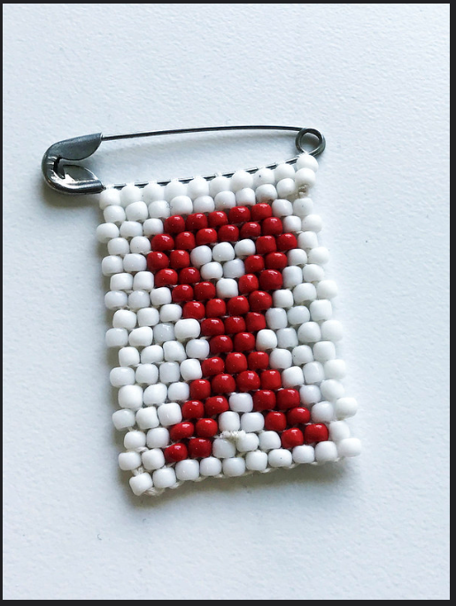
So……despite U=U being “lost in translation” for adolescents
U=U is a very powerful message for adolescents and youth in achieving 90-90-90 goals especially regarding developing sexual orientation and exploration at a time when relationships are likely unstable and disclosure to sexual partners is very unlikely…..
Why lost in translation for adolescents?
The U=Undetectable may be missing……
Which makes the U=untransmissible much more complicated

Slide 7
To achieve U=U, we need to be aware of, and address each of the challenges in 90-90-90 for adolescents and youth
UNAIDS 2017

Slide 8
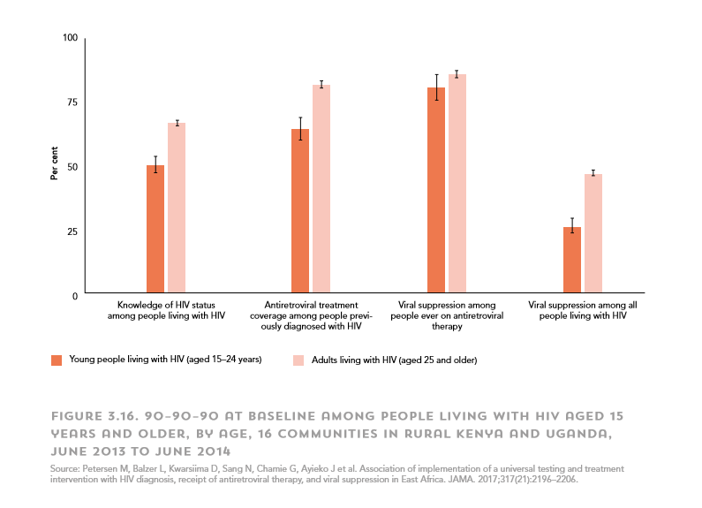
HIV CASCADE ADOLESCENTS……. 90-90-90?
78,949
40%
25%
11%
6%
- Congo, Mozambique, Nigeria, Uganda-36.5 % tested for HIV
- HIV+, 46-65% know their status (Population-based HIV Impact Assessments)
- On ART, virally suppressed 79% if denominator is those receiving VL testing, but 30% if account for “leaky” cascade
Zanoni, AIDS Patient Care STDs, 2014, Enane, J of Virus Eradication, 2018, UNAIDS 2017
Notes:
Need to check these articles…..put heading at the bottom

Slide 9
Vertical and horizontal HIV infection…..does it matter??
It depends……
Age and maturity level probably more important than mode of transmission
But there are issues specific to vertically infected compared to horizontally infected adolescents and youth depending on:
- Age at diagnosis
- Period of exposure to HIV and ART
- Neurocognitive functioning
- Orphanhood
- High risk behaviours (adherence, unprotected sex, alcohol, drugs)
- Maturity level
Should we be categorising adolescents as early or late presenters instead?

Slide 10
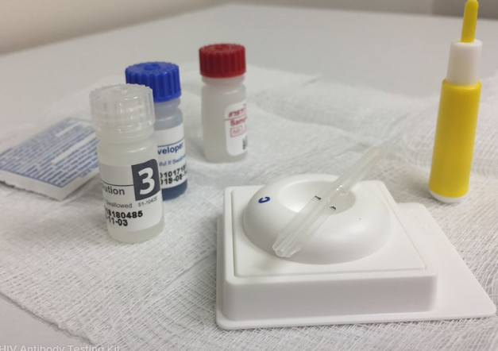
HIV testing, diagnosis and linkage

Slide 11
Test and diagnose
Despite adolescents and youth being a high risk population testing and diagnosis remains a significant challenge
Well adolescents/youth are likely to NOT access clinics and clinic-based testing
- 59% of HIV+ youth in the US remain undiagnosed
- In SSA, only 20% of HIV+ adolescent girls know their status (2013)
- Malawi, Zambia and Zimbabwe 46% 15-24 year olds aware of their status (2016)
We need to optimise opportunities at adolescent visits to obvious places e.g. Family planning, ANC, TB clinics, nutritional services
BUT we need even more effort to reach the “hard-to-engage” adolescents/youth
We need to make HIV testing simpler for adolescents
We need to involve Adolescent/Youth to achieve this!
Zanoni, AIDS Patient Care STDs, 2014;
UNICEF 2013; ICAP PHIA 2015/6
Notes:
ICAP population based surveys 2016 to measure HIV-incidence in Malawi, Zim, Zambia

Slide 12
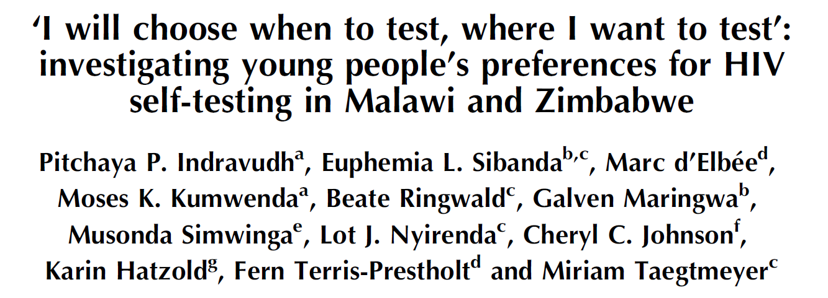
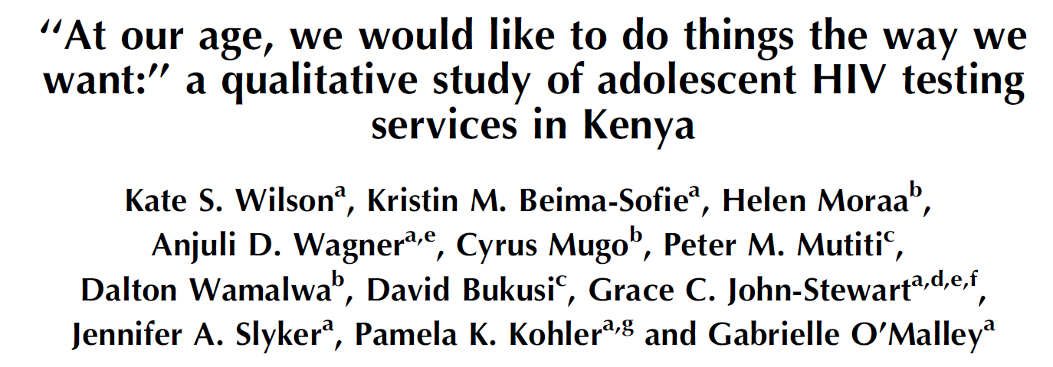
Indravudh, AIDS, 2017; Wilson, AIDS, 2017, Marano, AIDS, 2017, Kranzer, Lancet HIV, 2018

Slide 13
Yield and acceptability of HIV testing
Govindasamy, JIAS, 2015

Slide 14
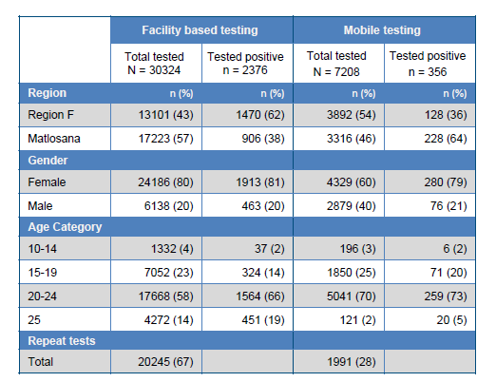
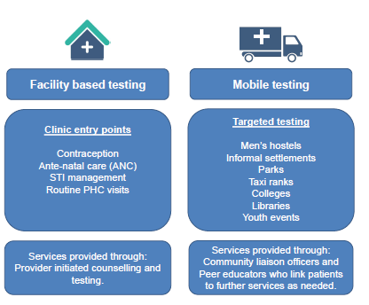
HIV POSITIVITY The overall HIV positivity rate across the two sub-districts was 7.3% (2732/37 532). Positivity was higher in primary health facilities (7.8%) than in mobile clinics and community settings (4.9%).
Acknowledgement: USAID
Beery, INTEREST Conference, 2018

Slide 15
Linkage and engagement in care remains a challenge……
Linkage and engagement barriers:
RED CARPET PROGRAM
Kenya
Legal and cultural related to age of consent for HIV testing and accessing treatment
Lack of, or incomplete implementation/uptake of adolescent and youth friendly services
Inadequate peer support/navigation
Individual factors:
- Age, race, sexual orientation
Slow rollout of community-based strategies for testing and linkage
Red carpet program:
559 adolescents and youth
Increased linkage (97.3%) compared to 56.5% before implementation (P<0.001).
All adolescents and youths received peer counseling and psychosocial support
Majority (79.0%) were initiated on treatment.
Retention increased from 66.0 to 90.0% at 3 months (P<0.001), and from 54.4 to 98.6% at 6 months
Ruria, AIDS, 2017; Philbin, AIDS Behav, 2014
Notes:
Engagement in care refers to the maintenance of HIV-related health care following initial linkage. (9) The process of engagement requires – at minimum – adherence to scheduled clinic visits (usually at defined 3-6 months intervals).(10) Although up to 90% of recently diagnosed individuals complete a second HIV-related visit after linkage, only 45%-55% complete at least one visit every 6 months
Initial engagement may be high but then about 30% adolescents in the US drop out of care (Philbin)

Slide 16
retention in care and VL suppression

Slide 17
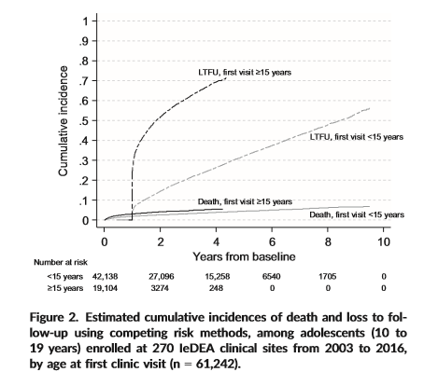
- 61,242 ALHIV from 270 clinics in 34 countries
- 69% entered care < 15 years, 31 % > 15 years
3.9 % mortality, 8% transfer out, 30% LTFU
4-year cumulative incidence mortality 3.9% versus 5.4% and LTFU 26% versus 69% (entering care < and > 15 years respectively)
Karaminia, JIAS, 2019

Slide 18
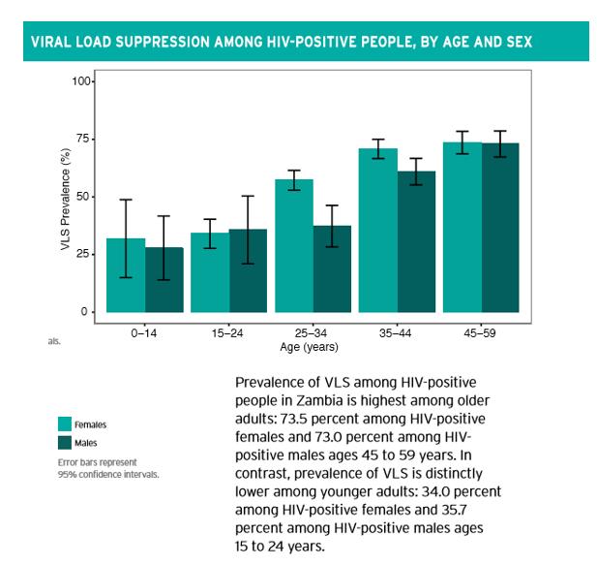
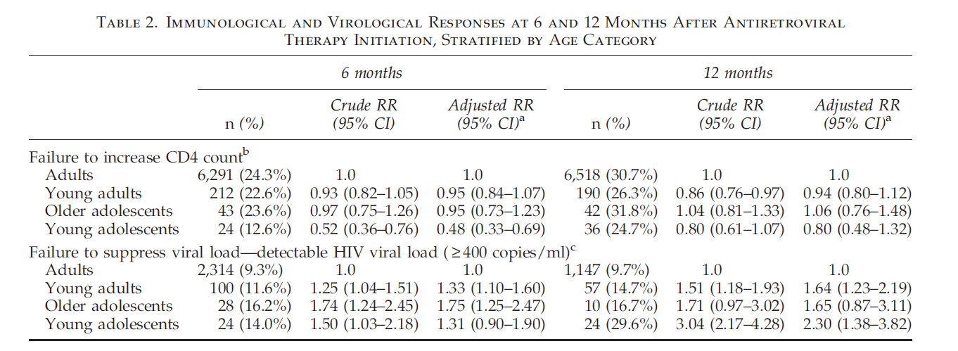
Young adolescents less likely LTFU after ART initiation (HR 0.43 95% CI 0.26–0.69) compared to older adolescents and young adults (HR 1.78 95% CI 1.34–2.36; HR 1.63 95% CI 1.41–1.89) compared to adults
Evans, AIDS Research and Human Retroviruses, 2013
ZAMPHIA Report 2016

Slide 19
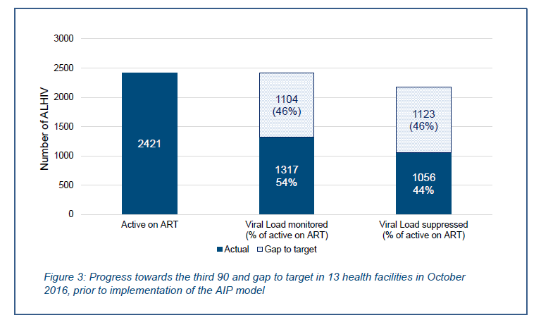
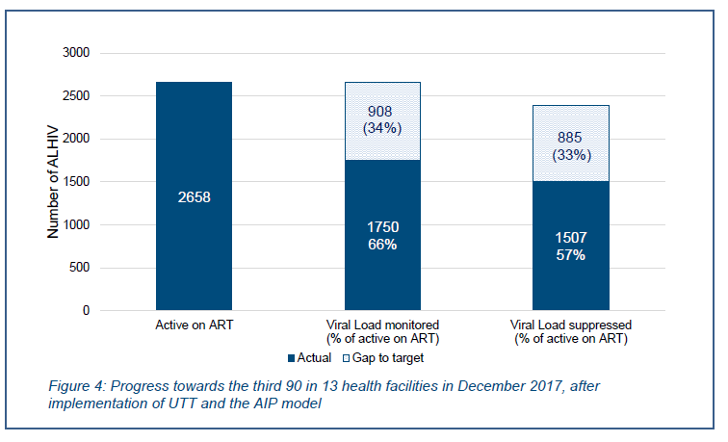
Mu et al (Asia):
- After initial suppression 1 in 5 risk of VF
- Incidence of VF 3.3/100 py
- Risk factors late VF (> 12 m after VS): Older age, rural setting, TB, PI-based regimen
Anderson (SA):
- Median age initiation 2.6 years, median follow-up 12.2 years
- 63.8% initiated NNRTI, 36.2% PI-based regimen
- At last follow up 49.6% on first line, 43.3% on second line
- 79.5% virally suppressed: 86.2% on first line, 76.8% on second line
- 10-year probability VF 56.7% (95% CI 48.3-65.5)
- 10 year probability of switching to second line 45.7%
Martin (SA):
Slight improvement in VL done and suppressed post-intervention
Mu, JAIDS, 2019; Anderson, SAMJ, 2019; Martin, INTEREST conference, 2018

Slide 20
Support for Adherence, retention and improved outcomes

Slide 21
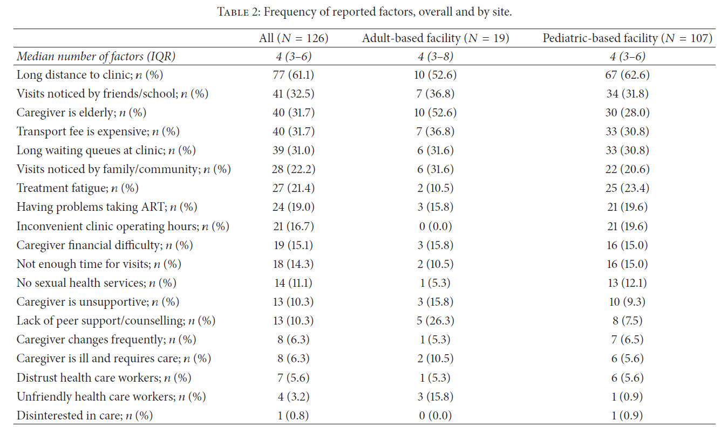
Reasons for adherence challenges …..
Chikwari, JAIDS, 2018; Maskew, AIDS Res and Treatment, 2016

Slide 22
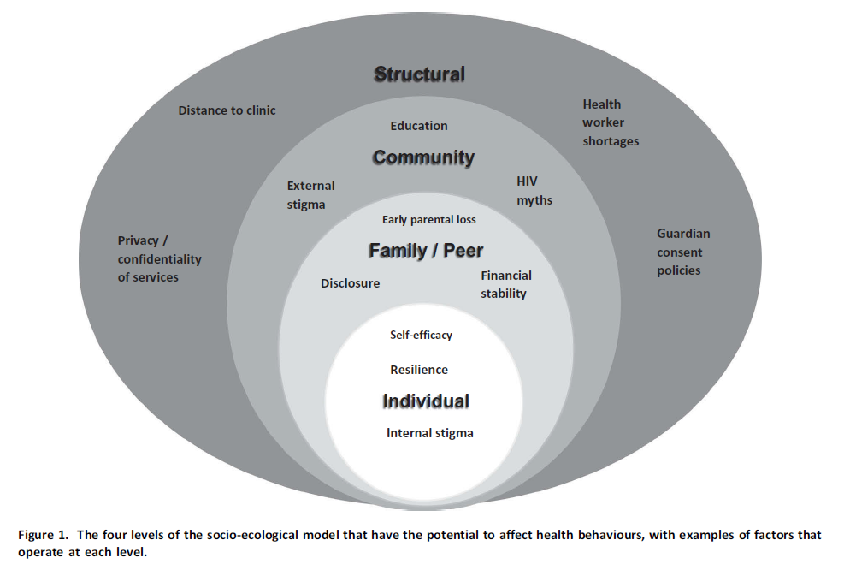
Williams, JIAS, 2017

Slide 23
Nge’no, J Adol Health 2018; Fatti JIAS, 2017, Kanters, JIAS, 2016; Lowenthal, JAMA, 2015; Ferrand, Lancet Child and adol Health 2017; Reif, Curr Opinion, 2018

Slide 24
Need to consider specific issues….
Mental Health
Disclosure
Sexual and reproductive health needs
Differentiated care models
Additional risk taking behaviours: Sex, drugs and rock ‘n roll!
Transition to adolescent or adult care
Pregnancy

Slide 25
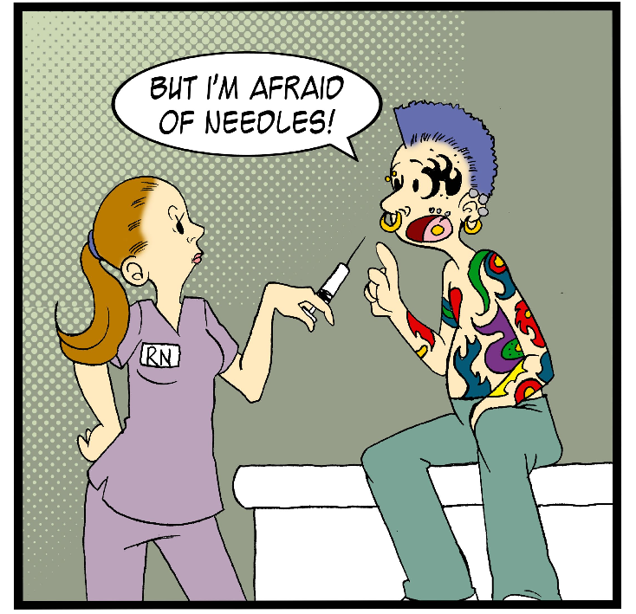
Treatment optimisation

Slide 26
Treatment optimisation
As we move towards a universal regimen containing DTG…..
Key considerations:
- Signal for NTD in adolescents/youth periconception/1st trimester
- For 2nd or 3rd line DTG-regimens-optimal NRTI backbone
- Emergence of resistance in treatment-experienced adolescents receiving DTG with an optimised background regimen
Need to ensure that adolescents are included in studies evaluating newer drugs and formulations to optimise ART
- Long acting formulations (injectables, implants, microneedle patches)
- Monoclonal neutralising antibody studies (VRCO1, VRCO7)
Zash, NEJM, 2018; Viani, J of Ped Inf Dis Soc, 2019

Slide 27
Margolis, Lancet, 2017; Murray, HIV Clin Trials, 2018; Rajoli, Clin Pharmacokinetics, 2017

Slide 28
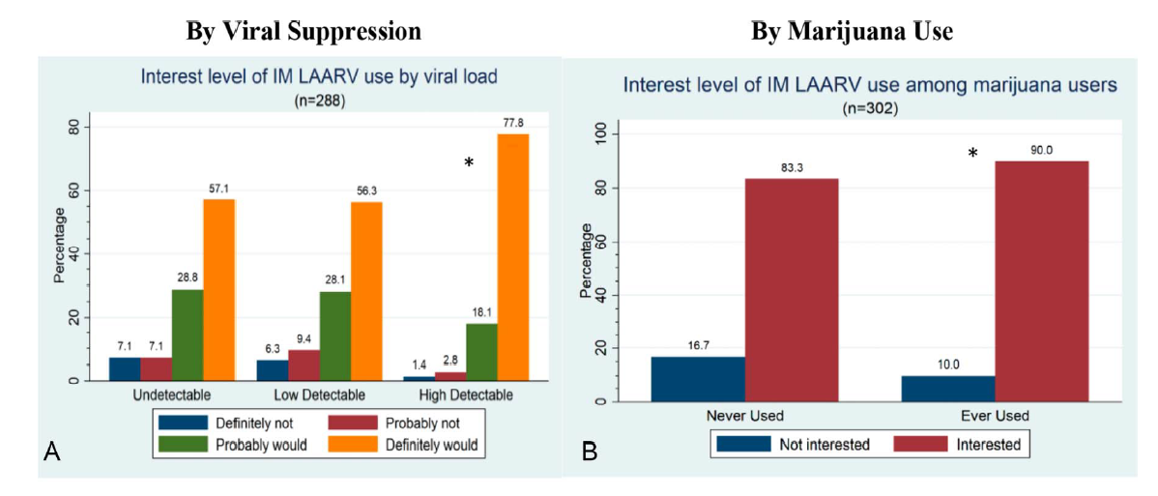
Need to include children and adolescents in research, specifically those struggling with adherence
Weld, JAIDS, 2019

Slide 29
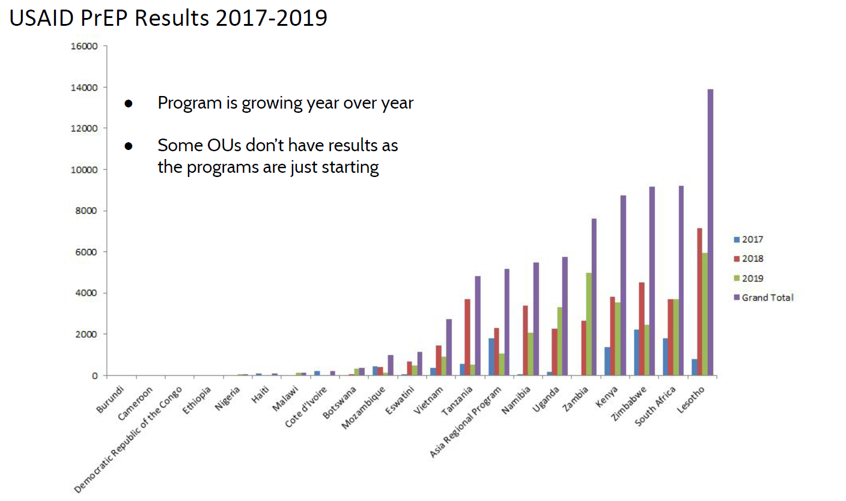
“Plan B” if U=U fails or is unreliable???
Oral PrEP
Although progress is being made…..
Still need substantial effort and scale up to expand access
Adherence is a challenge!
Newer formulations such as LAF being evaluated to overcome adherence difficulties with oral PrEP
Slide Courtesy of USAID, June 2019

Slide 30
Conclusion
U=U may be the strongest message to improve adolescent HIV and ART outcomes
Will be successful in 80% adolescents/youth on ART, VL suppressed
However, we do need to address issues along the 90-90-90 cascade to get there
Efforts need to be multi-layered, scalable
Need to improve access to optimised treatment especially in at-risk adolescents/youth
Back-up plan is PrEP……reliable and effective but adherence strategies need to be improved and rollout slow
Improved formulations are exciting for treatment and prevention-need to ensure that children and adolescents are INCLUDED!

Slide 31
ACKNOWLEDGEMENTS
The adolescents and youth who we have the privilege of working with
Gloria Maimela
Shobna Sawry
John Imrie
Faeezah Patel
PEPFAR
The ELMA Foundation

Slide 32
Thank you

